Slide 1
Extracting and Composing Robust Features with Denoising Autoencoders (DAE)
Pascal Vincent 蒙特利尔大学
2008 ICML

Slide 2
Outline
Scenario
Dimension reduction
Problem
Robust
Solution
DAE
Performance
Deep NN

Slide 3
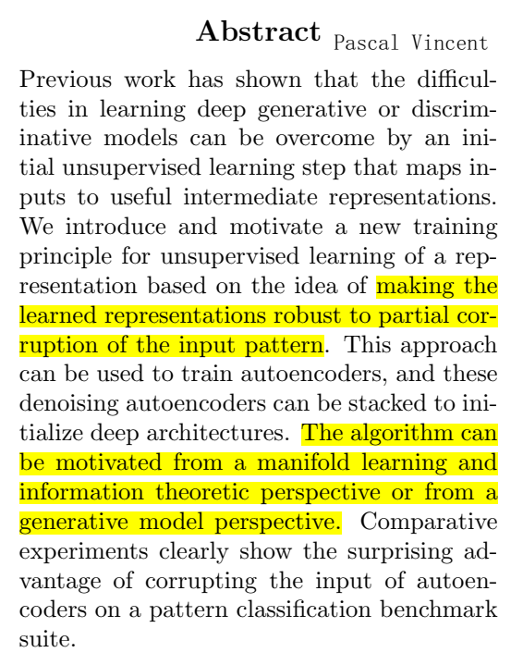
1
Scenario & Problem

Slide 4
1
Scenario & Problem
Scenario: Evaluate the embedding vector (code): “good” intermediate representations of the input pattern
It should be robust to the corrupted input
Compare DAE with other technologies:
Technique of augmenting the training data
Regularization
Robust coding over noisy channel

Slide 5

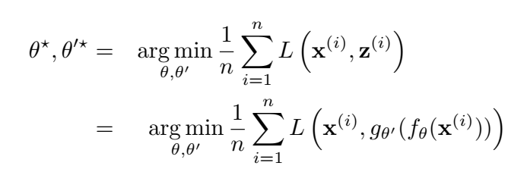
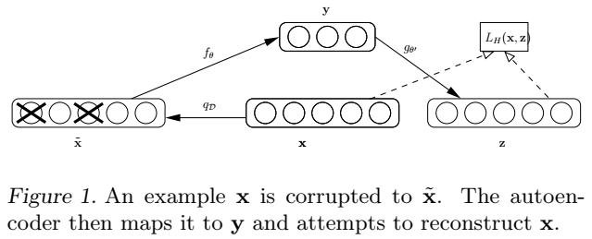
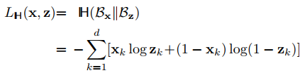


1
Solution
Auto Encoder:
Minimize the average reconstruction error
the reconstruction cross-entropy
if x is a binary vector
Denoising Auto Encoder:
the joint distribution

Slide 6
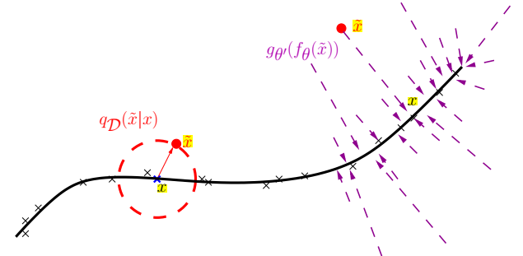
1
Analysis
Understanding DAE from various perspectives:
Manifold learning
Generative Model Perspective : don’t understand
Information Theoretic Perspective
minimize the expected reconstruction error =maximize a lower bound on mutual information I(X; Y )
Stochastic Operator Perspective
semi-parametric model

Slide 7
1
Experiment

Slide 8
1
Experiment

Slide 9
4
Conclusion

